Slide 1
EXPENSE TRACKER

Slide 2
INTRODUCTION
The main purpose of this application is to track all the expenses made by a user on a day to day basis . The app helps user to keep track of his expenses and notify him when he exceeds his limit of expenditure .

Slide 3
DESIGN OF SOFTWARE
LANGUAGES USED : HTML,JSP,SQL
DATABASE USED : SQL DATABASE
STYLE SHEETS :CSS
TOOLS : ECLLIPSE

Slide 4
CLASS DIAGRAM

Slide 5
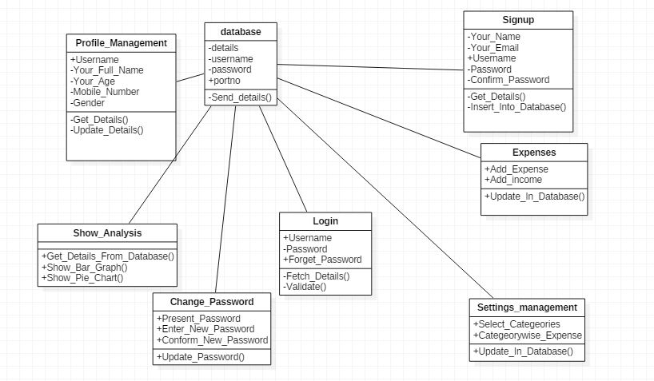

Slide 6
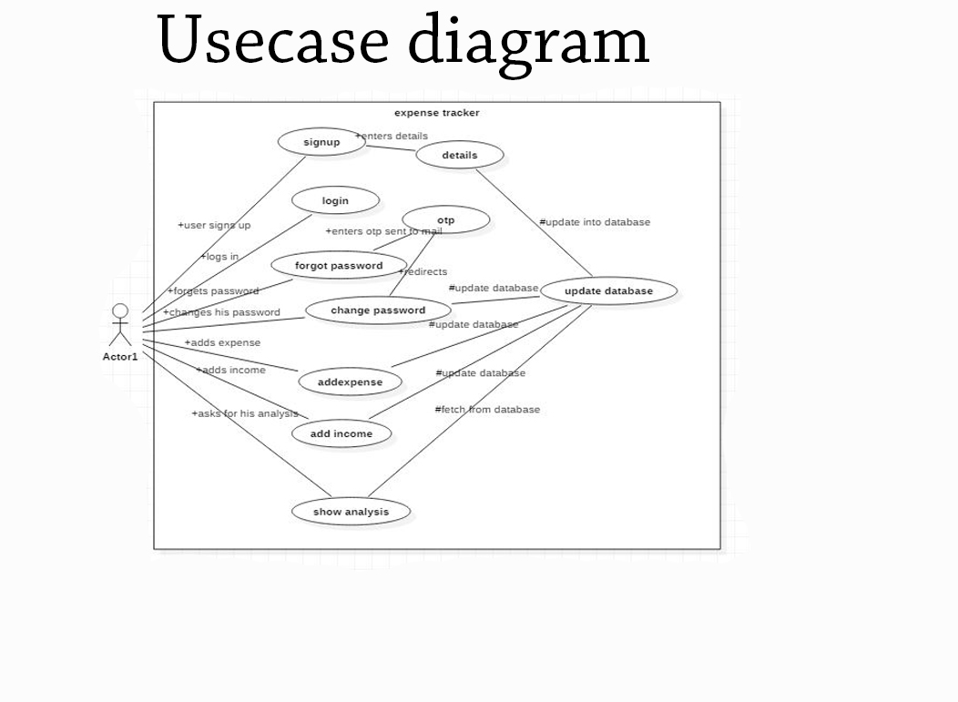

Slide 7
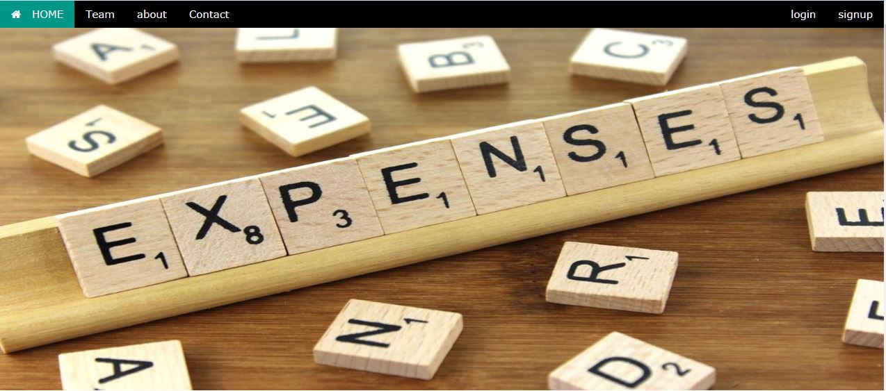

Slide 8
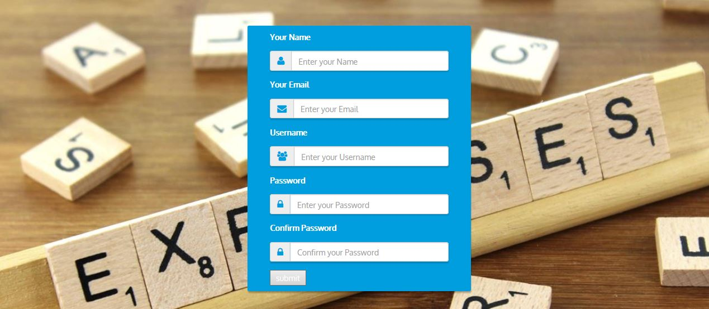

Slide 9
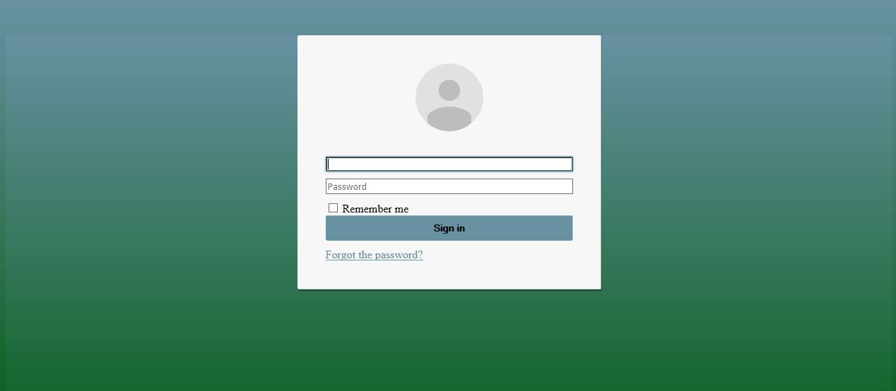

Slide 10
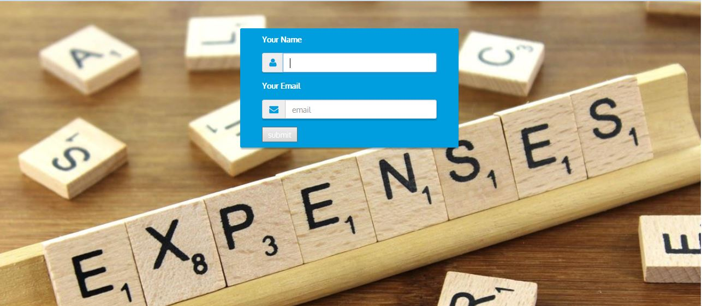

Slide 11
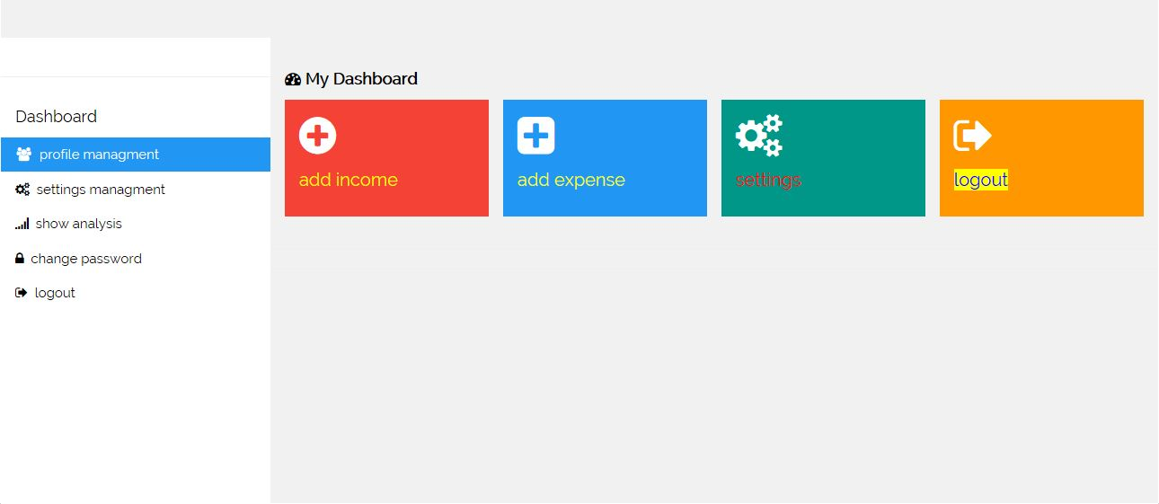

Slide 12
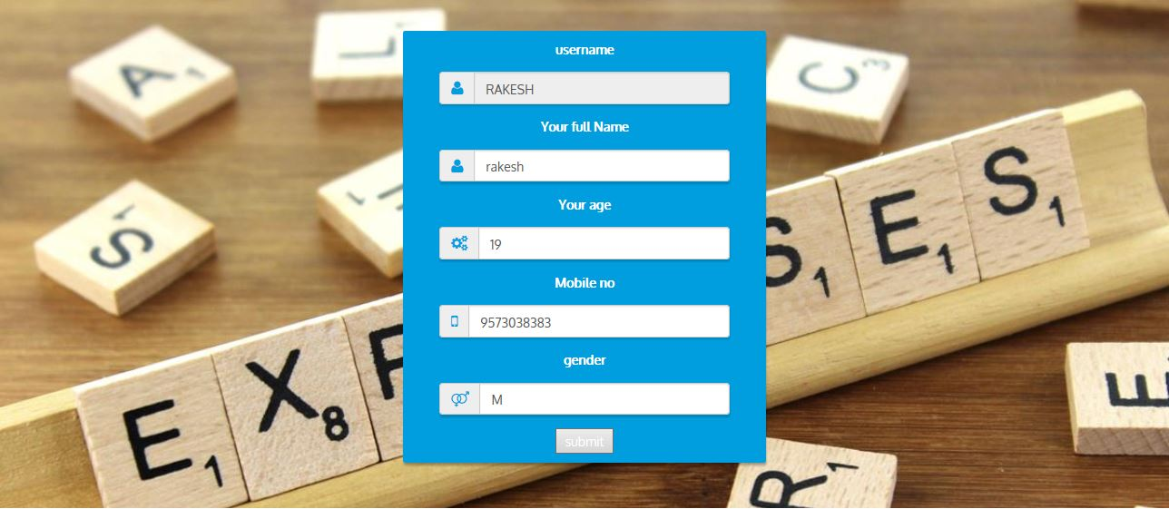

Slide 13
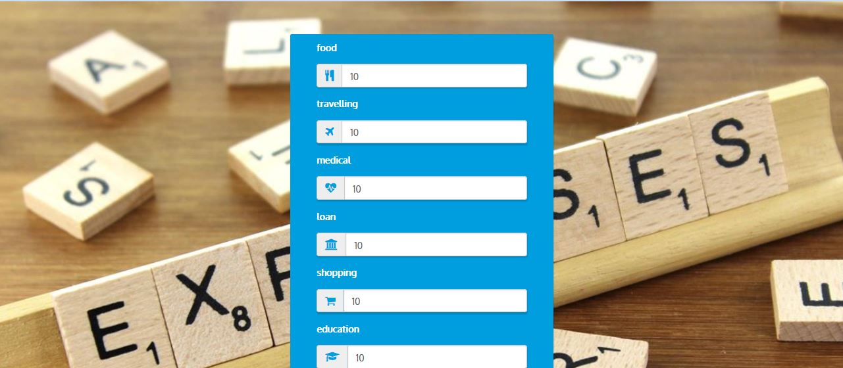

Slide 14
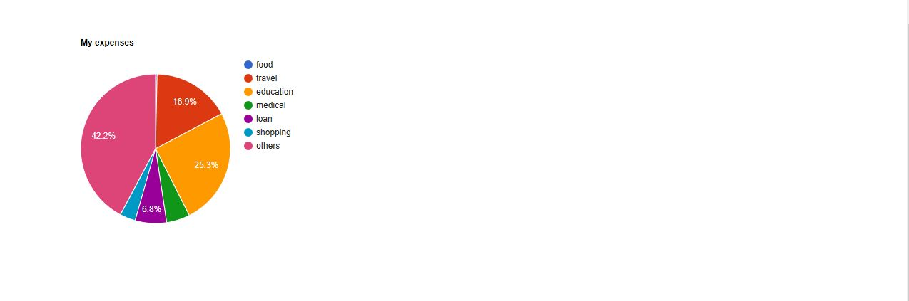

Slide 15
